Slide 1

Chapter 6: Project Time Management
Information Technology Project Management, Eighth Edition
Note: See the text itself for full citations.

Slide 2
Learning Objectives
Understand the importance of project schedules and good project time management
Discuss the process of planning schedule management
Define activities as the basis for developing project schedules
Describe how project managers use network diagrams and dependencies to assist in activity sequencing
Understand the relationship between estimating resources and project schedules
Explain how various tools and techniques help project managers perform activity duration estimates

Slide 3
Learning Objectives
Use a Gantt chart for planning and tracking schedule information, find the critical path for a project, and describe how critical chain scheduling and the Program Evaluation and Review Technique (PERT) affect schedule development
Understand how time management is addressed using Agile
Discuss how reality checks and discipline are involved in controlling and managing changes to the project schedule
Describe how project management software can assist in project time management and review words of caution before using this software

Slide 4
Importance of Project Schedules
Managers often cite delivering projects on time as one of their biggest challenges
Time has the least amount of flexibility; it passes no matter what happens on a project
Schedule issues are the main reason for conflicts on projects, especially during the second half of projects

Slide 5
Individual Work Styles and Cultural Differences Cause Schedule Conflicts
One dimension of the Meyers-Briggs Type Indicator focuses on peoples’ attitudes toward structure and deadline
Some people prefer to follow schedules and meet deadlines while others do not (J vs. P)
Difference cultures and even entire countries have different attitudes about schedules

Slide 6
Media Snapshot
In contrast to the 2002 Salt Lake City Winter Olympic Games (see Chapter 4’s Media Snapshot), planning and scheduling was very different for the 2004 Athens Summer Olympic Games and the 2014 Sochi Winter Olympic Gmes
Many articles were written before the opening ceremonies in Athens predicting that the facilities would not be ready in time. …the Greeks even made fun of critics by having construction workers pretend to still be working as the ceremonies began…but the games cost more than twice the planned budget
The 2014 Winter Olympic Games in Sochi, Russia, suffered even greater financial loss and were the most expensive games in history

Slide 7
Project Time Management Processes
Planning schedule management: determining the policies, procedures, and documentation that will be used for planning, executing, and controlling the project schedule
Defining activities: identifying the specific activities that the project team members and stakeholders must perform to produce the project deliverables
Sequencing activities: identifying and documenting the relationships between project activities
Estimating activity resources: estimating how many resources a project team should use to perform project activities
Estimating activity durations: estimating the number of work periods that are needed to complete individual activities
Developing the schedule: analyzing activity sequences, activity resource estimates, and activity duration estimates to create the project schedule
Controlling the schedule: controlling and managing changes to the project schedule

Slide 8
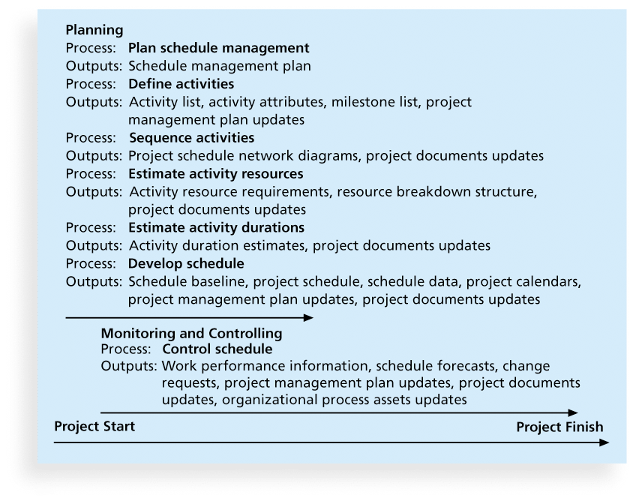
Figure 6-1. Project Time Management Summary

Slide 9
Planning Schedule Management
The project team uses expert judgment, analytical techniques, and meetings to develop the schedule management plan
A schedule management plan includes:
Project schedule model development
The scheduling methodology
Level of accuracy and units of measure
Control thresholds
Rules of performance measurement
Reporting formats
Process descriptions

Slide 10
Defining Activities
An activity or task is an element of work normally found on the work breakdown structure (WBS) that has an expected duration, a cost, and resource requirements
Activity definition involves developing a more detailed WBS and supporting explanations to understand all the work to be done so you can develop realistic cost and duration estimates

Slide 11
Activity Lists and Attributes
An activity list is a tabulation of activities to be included on a project schedule that includes
the activity name
an activity identifier or number
a brief description of the activity
Activity attributes provide more information such as predecessors, successors, logical relationships, leads and lags, resource requirements, constraints, imposed dates, and assumptions related to the activity

Slide 12
Milestones
A milestone is a significant event that normally has no duration
It often takes several activities and a lot of work to complete a milestone
They’re useful tools for setting schedule goals and monitoring progress
Examples include obtaining customer sign-off on key documents or completion of specific products

Slide 13
What Went Wrong?
At the U.S. Federal Bureau of Investigation (FBI), poor time management was one of the reasons behind the failure of Trilogy, a “disastrous, unbelievably expensive piece of vaporware, which was more than four years in the (un)making. The system was supposed to enable FBI agents to integrate intelligence from isolated information silos within the Bureau.”*
In May 2006, the Government Accounting Agency said that the Trilogy project failed at its core mission of improving the FBI’s investigative abilities and was plagued with missed milestones and escalating costs. Sentinel replaced Trilogy in 2007.
During a test exercise in 2011, Sentinel experienced two outages, and the FBI determined that the current hardware structure was inadequate. In 2014, the system still wasn’t working well.
*Roberts, Paul, “Frustrated contractor sentenced for hacking FBI to speed deployment,”
InfoWorld Tech Watch, (July 6, 2006).

Slide 14
Sequencing Activities
Involves reviewing activities and determining dependencies
A dependency or relationship is the sequencing of project activities or tasks
You must determine dependencies in order to use critical path analysis

Slide 15
Three types of Dependencies
Mandatory dependencies: inherent in the nature of the work being performed on a project, sometimes referred to as hard logic
Discretionary dependencies: defined by the project team., sometimes referred to as soft logic and should be used with care since they may limit later scheduling options
External dependencies: involve relationships between project and non-project activities

Slide 16
Network Diagrams
Network diagrams are the preferred technique for showing activity sequencing
A network diagram is a schematic display of the logical relationships among, or sequencing of, project activities
Two main formats are the arrow and precedence diagramming methods

Slide 17
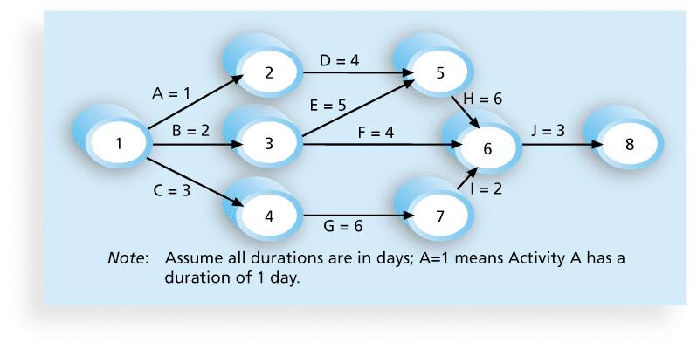
Figure 6-2. Network Diagram for Project X

Slide 18
Arrow Diagramming Method (ADM)
Also called activity-on-arrow (AOA) network diagrams
Activities are represented by arrows
Nodes or circles are the starting and ending points of activities
Can only show finish-to-start dependencies

Slide 19
Process for Creating AOA Diagrams
1. Find all of the activities that start at node 1. Draw their finish nodes and draw arrows between node 1 and those finish nodes. Put the activity letter or name and duration estimate on the associated arrow
2. Continuing drawing the network diagram, working from left to right. Look for bursts and merges. Bursts occur when a single node is followed by two or more activities. A merge occurs when two or more nodes precede a single node
3. Continue drawing the project network diagram until all activities are included on the diagram that have dependencies
4. As a rule of thumb, all arrowheads should face toward the right, and no arrows should cross on an AOA network diagram

Slide 20
Precedence Diagramming Method (PDM)
Activities are represented by boxes
Arrows show relationships between activities
More popular than ADM method and used by project management software
Better at showing different types of dependencies

Slide 21
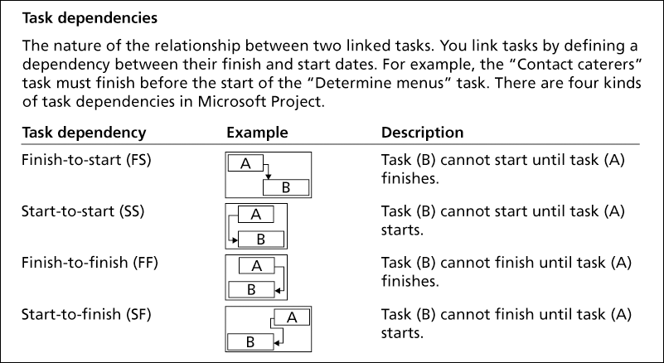
Figure 6-3. Task Dependency Types

Slide 22
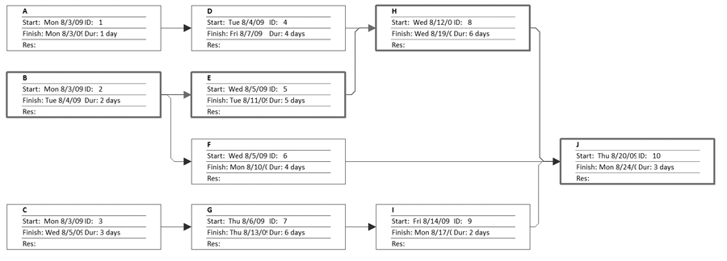
Figure 6-4. Sample PDM Network Diagram

Slide 23
Estimating Activity Resources
Before estimating activity durations, you must have a good idea of the quantity and type of resources that will be assigned to each activity; resources are people, equipment, and materials
Consider important issues in estimating resources
How difficult will it be to do specific activities on this project?
What is the organization’s history in doing similar activities?
Are the required resources available?
A resource breakdown structure is a hierarchical structure that identifies the project’s resources by category and type

Slide 24
Activity Duration Estimating
Duration includes the actual amount of time worked on an activity plus elapsed time
Effort is the number of workdays or work hours required to complete a task
Effort does not normally equal duration
People doing the work should help create estimates, and an expert should review them

Slide 25
Three-Point Estimates
Instead of providing activity estimates as a discrete number, such as four weeks, it’s often helpful to create a three-point estimate
an estimate that includes an optimistic, most likely, and pessimistic estimate, such as three weeks for the optimistic, four weeks for the most likely, and five weeks for the pessimistic estimate
Three-point estimates are needed for PERT and Monte Carlo simulations

Slide 26
Developing the Schedule
Uses results of the other time management processes to determine the start and end date of the project
Ultimate goal is to create a realistic project schedule that provides a basis for monitoring project progress for the time dimension of the project
Important tools and techniques include Gantt charts, critical path analysis, and critical chain scheduling, and PERT analysis

Slide 27
Gantt Charts
Gantt charts provide a standard format for displaying project schedule information by listing project activities and their corresponding start and finish dates in a calendar format
Symbols include:
A black diamond: a milestones
Thick black bars: summary tasks
Lighter horizontal bars: durations of tasks
Arrows: dependencies between tasks

Slide 28
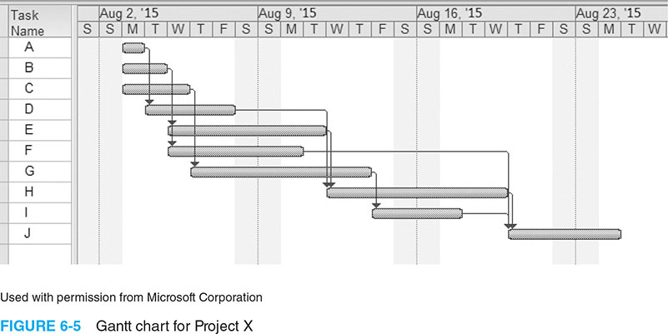
Figure 6-5. Gantt Chart for Project X

Slide 29
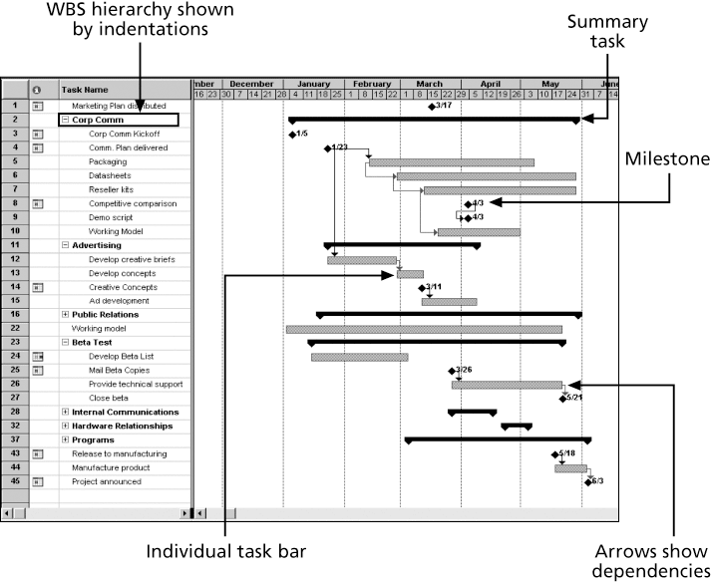
Figure 6-6. Gantt Chart for Software Launch Project

Slide 30
Adding Milestones to Gantt Charts
Many people like to focus on meeting milestones, especially for large projects
Milestones emphasize important events or accomplishments on projects
Normally create milestone by entering tasks with a zero duration, or you can mark any task as a milestone

Slide 31
SMART Criteria
Milestones should be
Specific
Measurable
Assignable
Realistic
Time-framed

Slide 32
Best Practice
Shawn Anchor suggests the 20-second rule in his book, The Happiness Advantage
People prefer the path of least resistance. For example, if you have to wait in line 20 seconds to get a second scoop of ice cream, you might resist it
Anchor recommends making it more difficult for yourself to be distracted at work by keeping email or websites closed while you are working
Save time by adding time to the distracting behaviors at work

Slide 33
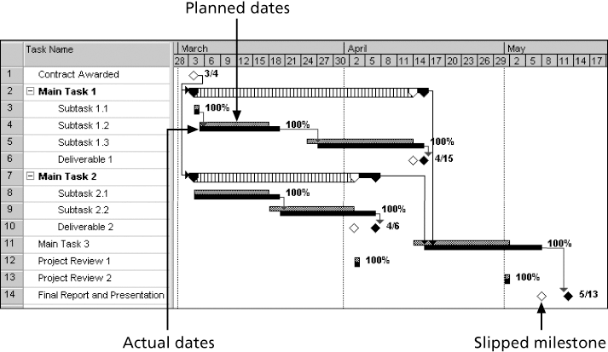
Figure 6-7. Sample Tracking Gantt Chart

Slide 34
Critical Path Method (CPM)
CPM is a network diagramming technique used to predict total project duration
A critical path for a project is the series of activities that determines the earliest time by which the project can be completed
The critical path is the longest path through the network diagram and has the least amount of slack or float
Slack or float is the amount of time an activity may be delayed without delaying a succeeding activity or the project finish date

Slide 35
Calculating the Critical Path
First develop a good network diagram
Add the duration estimates for all activities on each path through the network diagram
The longest path is the critical path
If one or more of the activities on the critical path takes longer than planned, the whole project schedule will slip unless the project manager takes corrective action

Slide 36
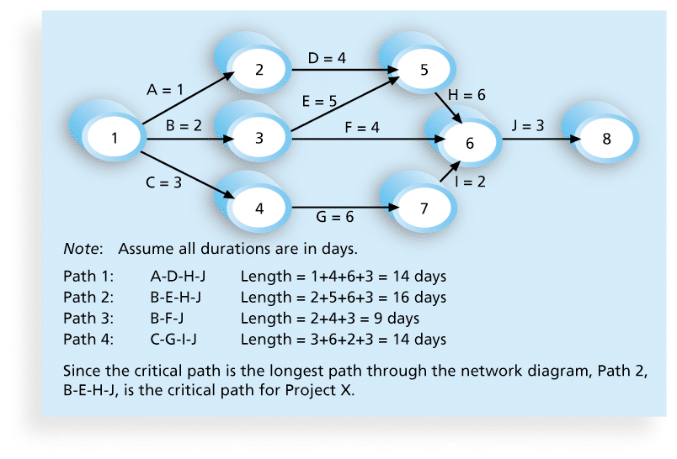
Figure 6-8. Determining the Critical Path for Project X

Slide 37
More on the Critical Path
A project team at Apple computer put a stuffed gorilla on the top of the cubicle of the person currently managing critical task
The critical path is not the one with all the critical activities; it only accounts for time
Remember the example of growing grass being on the critical path for Disney’s Animal Kingdom
There can be more than one critical path if the lengths of two or more paths are the same
The critical path can change as the project progresses

Slide 38
Using Critical Path Analysis to Make Schedule Trade-offs
Free slack or free float is the amount of time an activity can be delayed without delaying the early start of any immediately following activities
Total slack or total float is the amount of time an activity may be delayed from its early start without delaying the planned project finish date
A forward pass through the network diagram determines the early start and finish dates
A backward pass determines the late start and finish dates

Slide 39
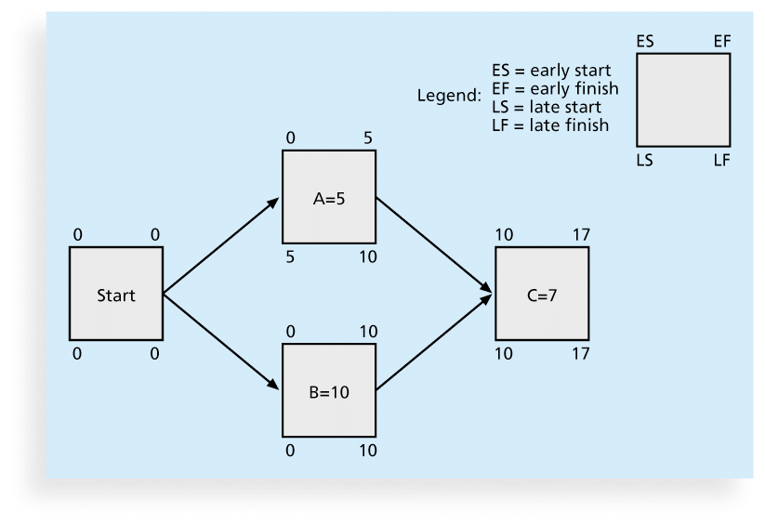
Figure 6-9. Calculating Early and Late Start and Finish Dates

Slide 40
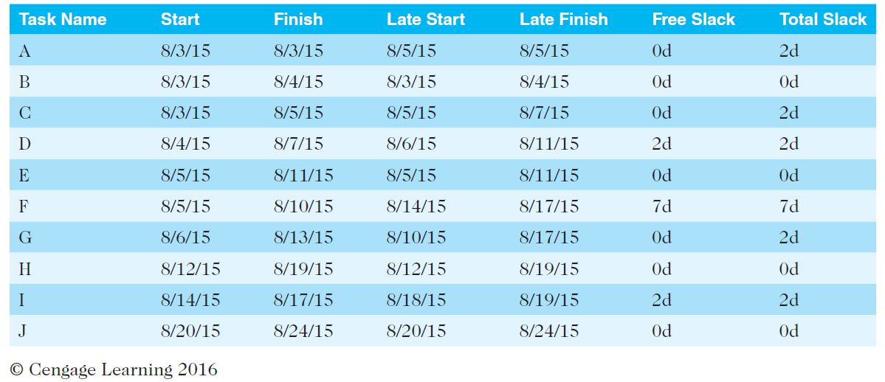
Table 6-1. Free and Total Float or Slack for Project X

Slide 41
Using the Critical Path to Shorten a Project Schedule
Three main techniques for shortening schedules
Shortening durations of critical activities/tasks by adding more resources or changing their scope
Crashing activities by obtaining the greatest amount of schedule compression for the least incremental cost
Fast tracking activities by doing them in parallel or overlapping them

Slide 42
Importance of Updating Critical Path Data
It is important to update project schedule information to meet time goals for a project
The critical path may change as you enter actual start and finish dates
If you know the project completion date will slip, negotiate with the project sponsor

Slide 43
Critical Chain Scheduling
Critical chain scheduling
a method of scheduling that considers limited resources when creating a project schedule and includes buffers to protect the project completion date
Uses the Theory of Constraints (TOC)
a management philosophy developed by Eliyahu M. Goldratt and introduced in his book The Goal.
Attempts to minimize multitasking
when a resource works on more than one task at a time

Slide 44
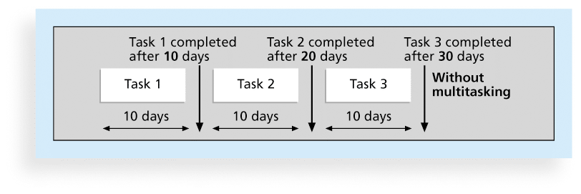
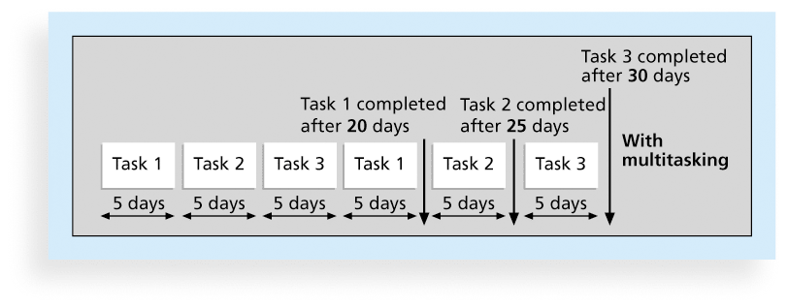
Figures 6-10.a and b. Multitasking Example

Slide 45
Buffers and Critical Chain
A buffer is additional time to complete a task
Murphy’s Law states that if something can go wrong, it will
Parkinson’s Law states that work expands to fill the time allowed
In traditional estimates, people often add a buffer to each task and use it if it’s needed or not
Critical chain scheduling removes buffers from individual tasks and instead creates
a project buffer or additional time added before the project’s due date
feeding buffers or additional time added before tasks on the critical path

Slide 46
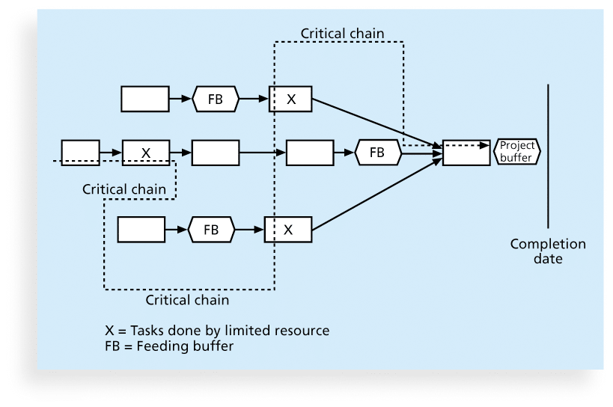
Figure 6-11. Example of Critical Chain Scheduling

Slide 47
What Went Right?
Scheduling at healthcare clinic’s can be more efficient by using critical chain scheduling
The National University Hospital in Singapore decreased patient admission times by more than 50 percent
See www.goldratt.com for more information

Slide 48
Program Evaluation and Review Technique (PERT)
PERT is a network analysis technique used to estimate project duration when there is a high degree of uncertainty about the individual activity duration estimates
PERT uses probabilistic time estimates
duration estimates based on using optimistic, most likely, and pessimistic estimates of activity durations, or a three-point estimate

Slide 49
PERT Formula and Example
PERT weighted average =
optimistic time + 4X most likely time + pessimistic time
6
Example:
PERT weighted average =
8 workdays + 4 X 10 workdays + 24 workdays = 12 days 6
where optimistic time= 8 days
most likely time = 10 days, and
pessimistic time = 24 days
Therefore, you’d use 12 days on the network diagram instead of 10 when using PERT for the above example

Slide 50
Agile and Time Management
Core values of the Manifesto for Agile Software Development are
Customer collaboration over contract negotiation
Responding to change over following a plan
The product owner defines and prioritizes the work to be done within a spring, so collaboration and time management are designed into the process
Teams focus on producing a useful product in a specified timeframe with strong customer input
Don’t emphasize defining all the work before scheduling it

Slide 51
Schedule Control Suggestions
Perform reality checks on schedules
Allow for contingencies
Don’t plan for everyone to work at 100% capacity all the time
Hold progress meetings with stakeholders and be clear and honest in communicating schedule issues

Slide 52
Controlling the Schedule
Goals are to know the status of the schedule, influence factors that cause schedule changes, determine that the schedule has changed, and manage changes when they occur
Tools and techniques include
Progress reports
A schedule change control system
Project management software, including schedule comparison charts like the tracking Gantt chart
Variance analysis, such as analyzing float or slack
Performance management, such as earned value (chapter 7)

Slide 53
Reality Checks on Scheduling
First review the draft schedule or estimated completion date in the project charter
Prepare a more detailed schedule with the project team
Make sure the schedule is realistic and followed
Alert top management well in advance if there are schedule problems

Slide 54
Working with People Issues
Strong leadership helps projects succeed more than good PERT charts
Project managers should use
empowerment
incentives
discipline
negotiation

Slide 55
Using Software to Assist in Time Management
Software for facilitating communications helps people exchange schedule-related information
Decision support models help analyze trade-offs that can be made
Project management software can help in various time management areas

Slide 56
Global Issues
Microsoft tell the customer story of Mexico’s Secretary of Economy, who wanted to ensure that IT initiatives aligned with business goals and improved project management efficiency
After implementing new software, their IT team could handle four times the number of concurrent projects without adding more staff

Slide 57
Words of Caution on Using Project Management Software
Many people misuse project management software because they don’t understand important concepts and have not had training
You must enter dependencies to have dates adjust automatically and to determine the critical path
You must enter actual schedule information to compare planned and actual progress

Slide 58
Chapter Summary
Project time management is often cited as the main source of conflict on projects, and most IT projects exceed time estimates
Main processes include
Plan schedule management
Define activities
Sequence activities
Estimate activity resources
Estimate activity durations
Develop schedule
Control schedule

